Slide 1
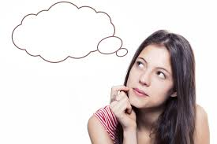
Use your thought bubble!

Slide 2
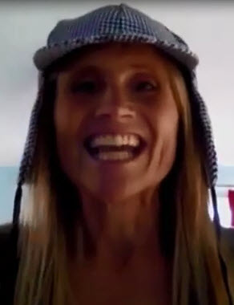
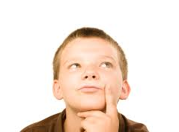
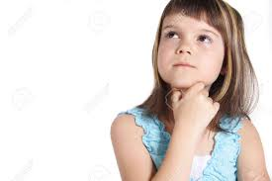
Thought bubbles are the things I think inside of my head. No one can hear my thought bubble words. Thought bubbles are private.
private
private
private

Slide 3
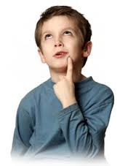
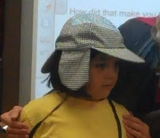
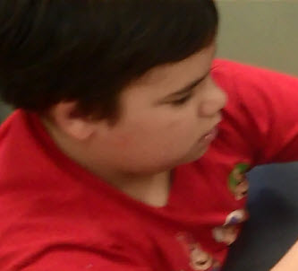
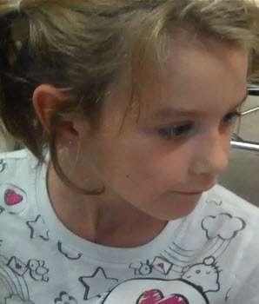
Everyone has different thoughts
in their thought bubbles.
How do you…
II wonder…
What’s that noise?
Can I …

Slide 4
I can have nice thoughts or mean thoughts in my thought bubble. It is ok. Thought bubbles are private and no one can hear them, so I can think whatever I want and not
get anyone mad at me!
Nice thoughts or mean thoughts! It’s ok in the thought bubble!

Slide 5
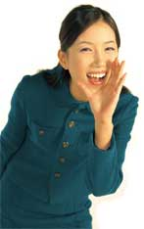
Then there are talking bubbles. Those are the words that come out of my mouth. People can hear my talking bubbles.
People can hear my talking bubble words.

Slide 6
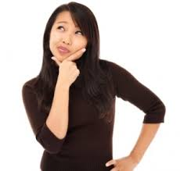
Because people can hear my talking bubble words, I need to remember that only nice words belong in the talking bubble. It is ok to have mean thoughts in my thought bubble, but it is NEVER ok to have mean words in my talking bubble.
Nice or mean thoughts in thought bubble. It’s ok!
Nice words ONLY

Slide 7
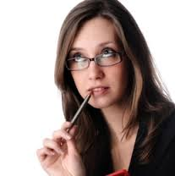
If I have mean words in my talking bubble other people may get mad or sad. Other kids may not like me. If I use too many mean words in my talking bubble, later no one will want to hang out with me. Kids like kids who have NICE words in their talking bubbles.
I would like for other kids to play with me. I will remember to leave mean words in thought bubble!
Oh, yeah, only nice words in talking bubble!

Slide 8
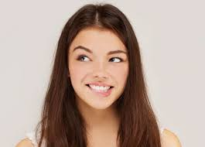
I will try to do a good job of remembering to keep my mean words in my thought bubble. This is what is EXPECTED. My teachers may help me to remember by saying, “keep it in your thought bubble”. Then I can try again!
Oh, yeah, mean words stay in thought bubble!
Keep it in your thought bubble.

Slide 9
When I do what is EXPECTED and keep my mean words in my thought bubble, My teachers will be very happy. The other kids will be very happy. Kids will want to be around me. They will have good thoughts about me! Way to go!
Good job remembering your thought bubble!

